Slide 1
Ch 3: Development and Deployment of Information at the Functional Level
Business Intelligence & Analytics

Slide 2
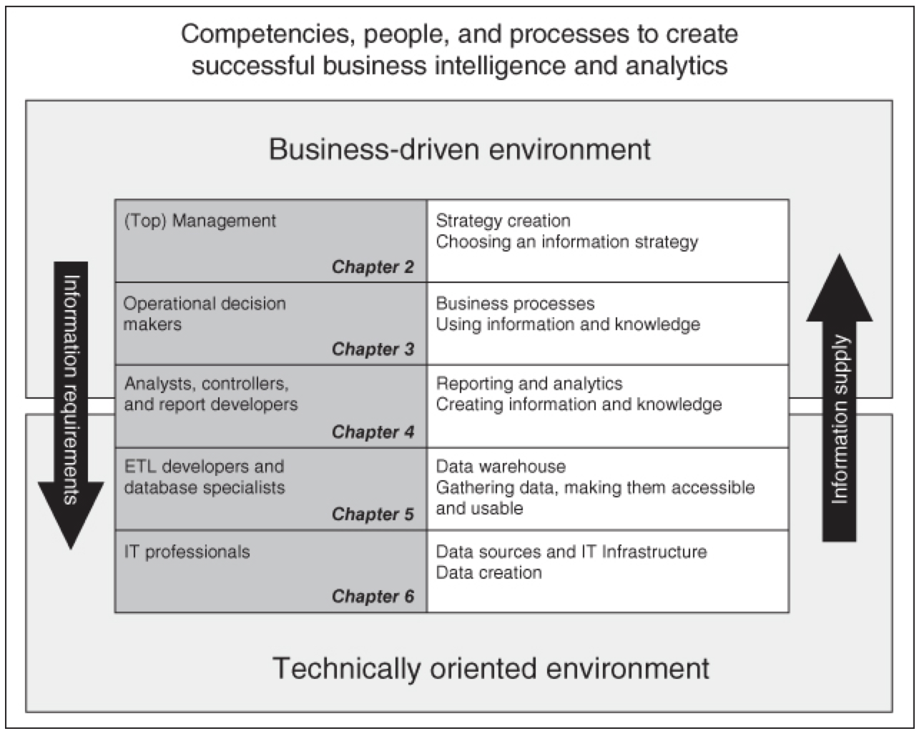
Business analytics model

Slide 3
Business analytics model

Slide 4
Business analytics model
Identify how to get from having some overall objectives for a department to specifying information and data requirements.

Slide 5
Business analytics model
Identify how to get from having some overall objectives for a department to specifying information and data requirements.
We discuss the relationship between BA and the operational level and the relationship between strategic plans and how to operationalize them with a focus on the BA function's deliveries.

Slide 6
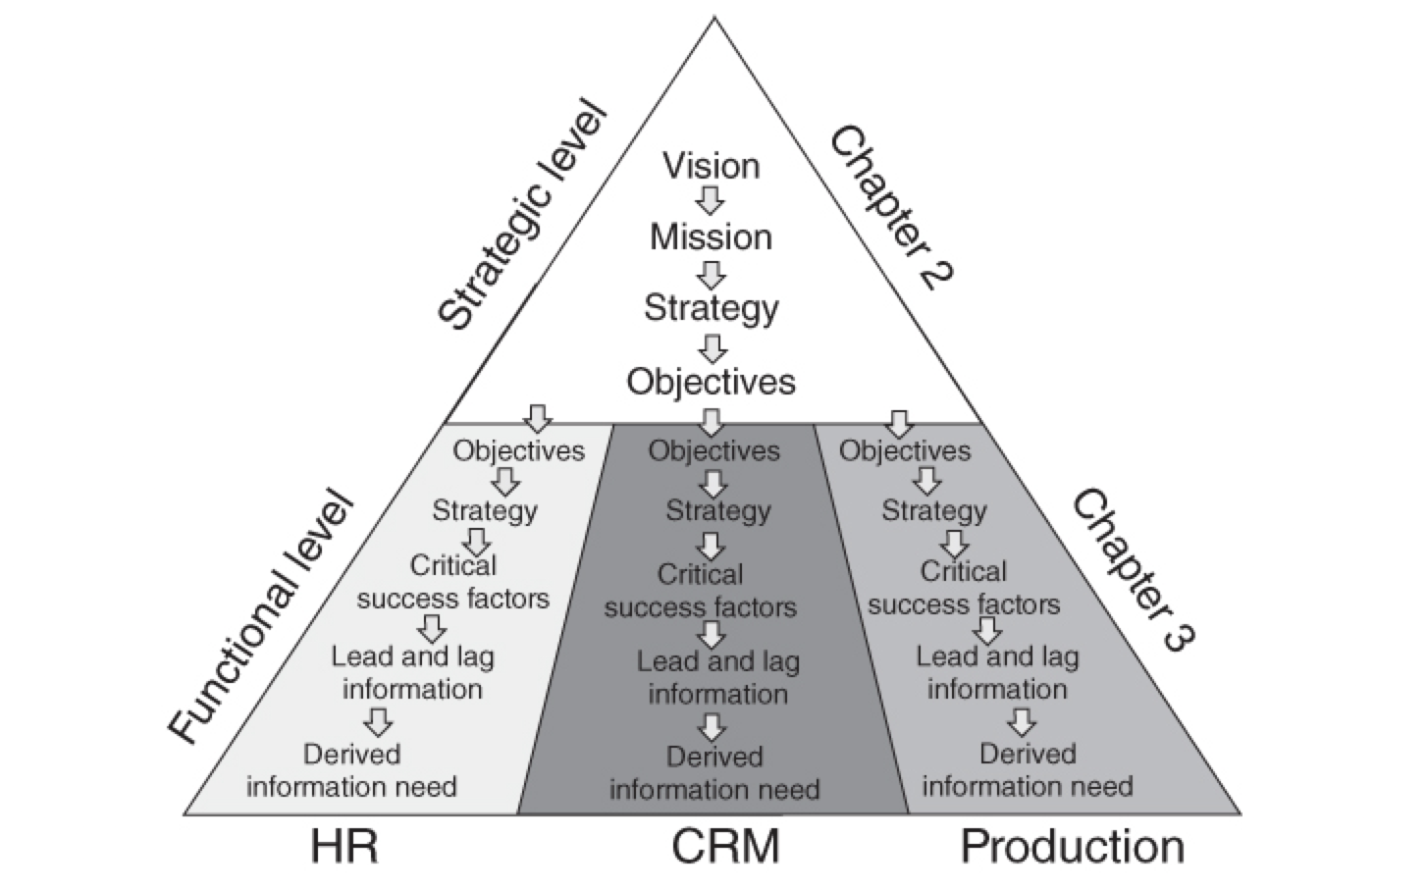

Slide 10
Just as we need to formulate a customer relationship management (CRM) strategy to reflect the overall strategy and its requirements to the CRM function, we also need to have an information strategy in place that reflects the information and data requirements placed by corporate strategy to the BA function.

Slide 11
Corporate Strategy: Set of objectives to meet a particular business goal

Slide 12
Corporate Strategy: Set of objectives to meet a particular business goal
Information Strategy: set of data requirements to achieve the corporate strategy

Slide 13
Examples
CRM Department
Establishment of a new process
Data stored across many data warehouses
Drowning in data while thirsting for knowledge

Slide 14
Examples
CRM Department
Establishment of a new process
Data stored across many data warehouses
Drowning in data while thirsting for knowledge
Call Center
Monitor and improve operation processes
Focus more on optimizing operational processes that already exist
Offer 11 suggestions for processes that could constitute initial areas for optimization
List KPIs to use at functional level

Slide 15
Lead vs lag
 | Lead | Lag
Definition | “Something that comes before” | “Something that comes after”
Collection strategy | Knowledge necessary for getting a process started/improve existing | Continuous measuring of how the process is meeting objectives
Systems | Typically comes from ad hoc projects | Conventionally automated reporting on key indicators

Slide 16
Chapter 2: Strategy development
Chapter 3:Define information needed
Chapter 4: Data collection/creation

Slide 17


